Slide 1
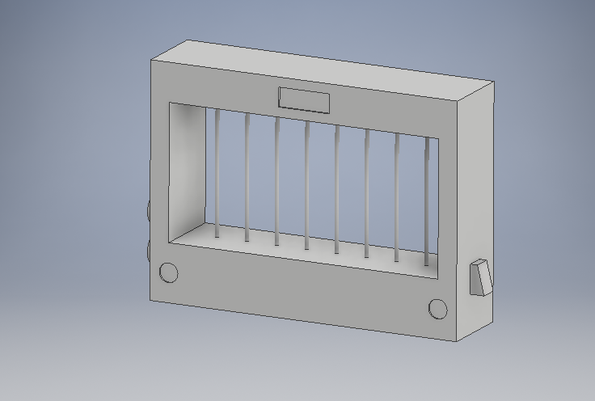
Laser Instrument
Luke Hazelton - CpE
Alexis Lamb - CpE
Erik Lim - CpE
Krystyn Wikoff - CpE
Notes:
Luke
This is where we introduce ourselves and give a visual reference, so the audience knows what we’re talking about for the rest of the presentation.

Slide 2
Motivation
Regular instruments are heavy
It is difficult to carry multiple instruments at once
Strings require tuning and maintenance
Owning instruments can get expensive
Different instruments have unique playing methods
Notes:
Luke
Motivation = Problems, NOT solutions

Slide 3
Goals and Objectives
Lightweight, compact, portable
Multiple instrument outputs
Lasers in place of strings or keys
Cheaper alternative
Graphical display to help assist performance
Connectivity with mobile application
Notes:
Erik

Slide 4
Requirement Specifications
Component | Parameter | Specification
Battery | Lifespan | 1+ hour
Device | Dimensions (L x W x D) | 12” x 18” x 5”
Weight | Maximum Weight | 10 lbs
Audio Playback | Response Time | < 1 second
Output Volume | Sound Volume | > 30 dB
Mobile Application | Wireless Range | ≥ 3 feet
Notes:
Alexis
Battery:
Device: keep compact and portable
Weight: light and portable
Playback: aiming for real-time but spec is 1sec
Volume: 30 = quite rural area; 40 = library or lowest limits of urban ambient sound
Mobile:

Slide 5
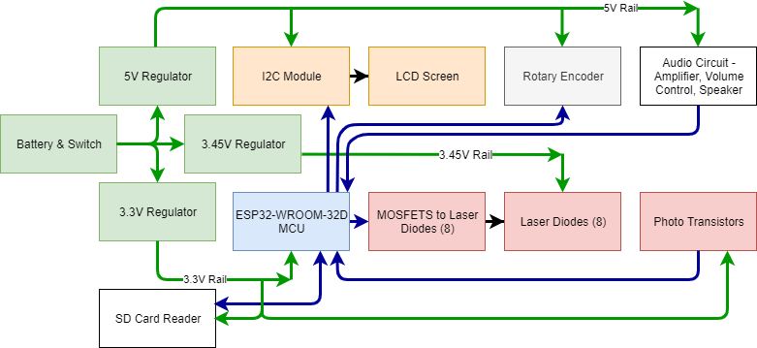
Block Diagram
Notes:
Krystyn
This is all of our electrical components. We are looking at three different needs for power – our microcontroller requires the standard 3.3V, and the LCD requires 5 V. But our smaller components like our laser diodes and photo transistors need something in between, as reviews show these components not lasting well at their specified electrical characteristics. All our electrical components receive some type of instruction from the MCU.

Slide 6
Components

Slide 7
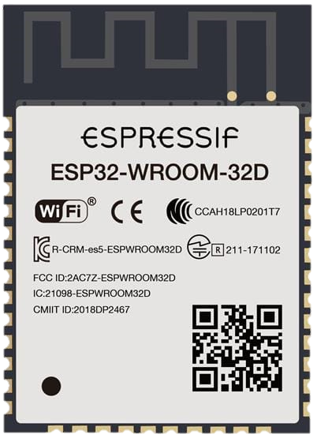
MCU - ESP32-WROOM-32D
Extensive documentation through Espressif, the chip creator
Bluetooth and Wi-Fi
Inexpensive
Small
Notes:
Krystyn
The brains of our project is our ESP32 chip, a chip with connectivity and a lot of pins as you can see. We chose the WROOM model because of its dual core, so that it could handle connecting to a phone via Bluetooth and the rest of the various input/output that it will be handling. With 36 GPIO pins, the chip can handle the 8 laser diodes, the 8 transistors, the audio out, SPI protocol to an SD card and I2C to the LCD screen, along with the rotary encoder for instrument selection. More than that, the chip’s creator company has thorough documentation with the opportunity to effectively program this chip to handle what is required. The best part of this chip is that we get all of this for only $3.80 a chip from Mouser.

Slide 8
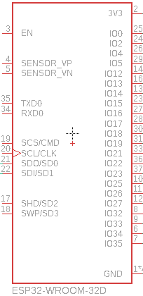
MCU - ESP32-WROOM-32D
Dual-core chip
DAC and ADC internally handled pins
36 I/O Pins
C/C++
Notes:
Krystyn
The brains of our project is our ESP32 chip, a chip with connectivity and a lot of pins as you can see. We chose the WROOM model because of its dual core, so that it could handle connecting to a phone via Bluetooth and the rest of the various input/output that it will be handling. With 36 GPIO pins, the chip can handle the 8 laser diodes, the 8 transistors, the audio out, SPI protocol to an SD card and I2C to the LCD screen, along with the rotary encoder for instrument selection. More than that, the chip’s creator company has thorough documentation with the opportunity to effectively program this chip to handle what is required. The best part of this chip is that we get all of this for only $3.80 a chip from Mouser.

Slide 9
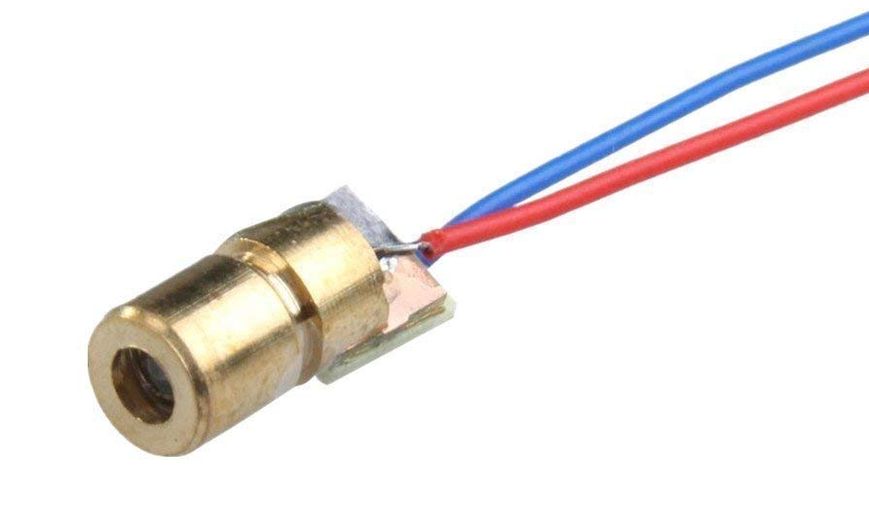
Laser Diodes
HiLetgo 650 nm Red Laser
$0.55 unit cost
5V working voltage
18 mm tube length
Notes:
Alexis
650 nm standard for red lasers
Red lasers are the most common color wavelength
Makes them easily accessible and affordable

Slide 10
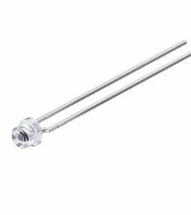
Phototransistors
The SFH 3310 Phototransistor
$0.879 unit price on Mouser
Flat-head design for optimal laser readings
Notes:
Alexis
Phototransistor chosen because:
LDR (light dependent resistors) banned in certain countries b/c of cadmium sulfide
Photodiodes require amplifier (additional component)
Flat-head design allows a larger receiving angle from the phototransistors

Slide 11
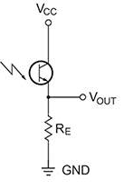
Lasers and Sensors
Lasers emit continuous beams onto sensor
Broken light beams will produce a musical note
ESP32 analog pins assign a value of 0 to 4095 for voltage levels
Voltages that cross a threshold will consider a laser beam broken
Notes:
Alexis
Continuous lasers
Laser diodes supplied continuous 5 V while device is “ON”
When user “breaks” light beam, notifies MCU
That analog threshold has been crossed
MCU communicates with audio storage based on sensor blocked
Corresponding musical note(s) are played

Slide 12
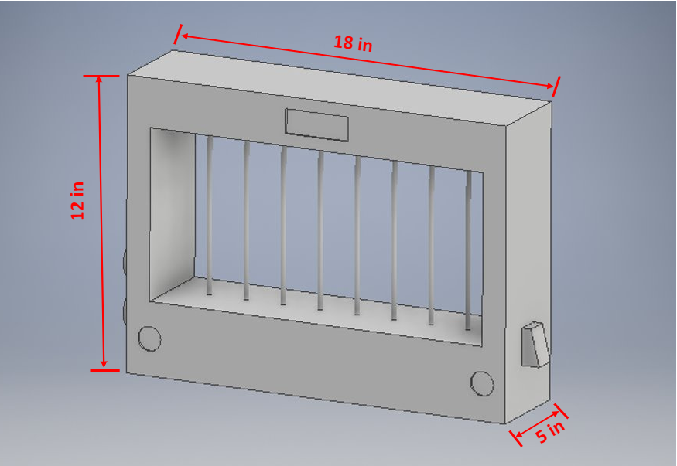
Frame Design
Length for 8 diodes/sensors
Width accommodates widest internal component (PCB)
Height for playability space
Bottom fits all internal components
Notes:
Alexis
Design accommodates 8 notes = 1 complete octave
Beams in CAD represent laser beams

Slide 13
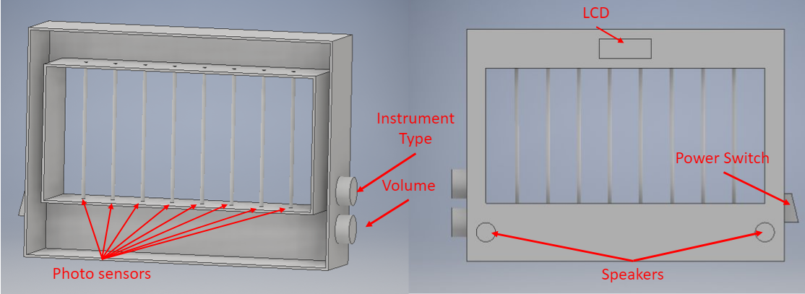
Frame Design Cont.
Notes:
Alexis
LCD mounted front and center
Laser diodes on top pointing downward
Phototransistors mounted bottom to complement lasers
MCU, battery, speakers, and physical/electrical components bottom

Slide 14
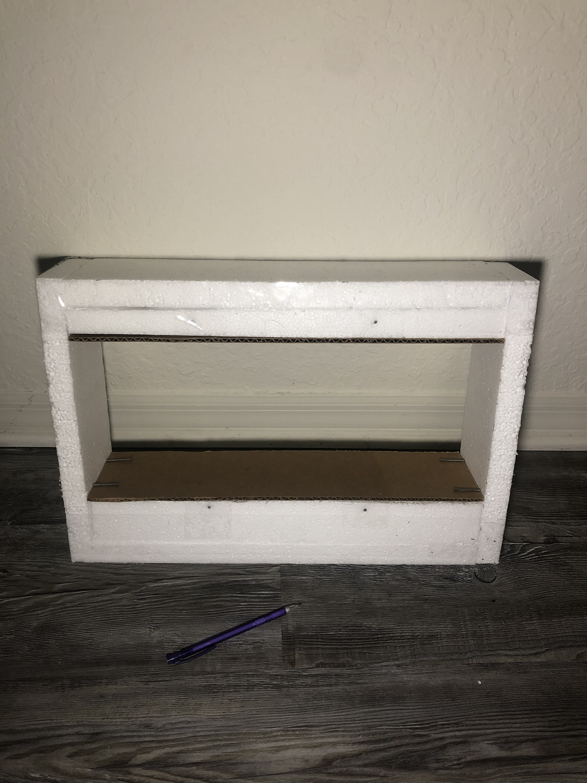
Frame Material
Many options
Styrofoam, wood, metal, plastic
Decided on 3D printing plastic
Lightweight
Rigid
Cheap
Modular
Notes:
Luke

Slide 15

Operation Safety
Frame reduces eye exposure to laser diodes
Downward laser orientation
Minimal reflection of laser from material
Frame material is heat and water resistant
Protects user from internal hazards
Protects components from external hazards
Maximum output volume will not damage ears
Notes:
Luke
Due to the possibility of harm to eyes from the laser diodes, the team had to look into ensuring that the project would not possibly shine lights into users eyes, or reflect off of our material into eyes. Although these are low power lasers, they still come with warnings on the packages, meaning there could be damaged caused by looking into them.
Audio output MINIMUM is 30dB

Slide 16
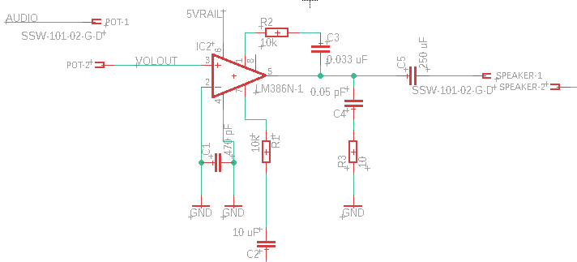
Audio Output
Utilizes the DAC pin option on the ESP32
TI LM386N-1 Amplifier
10k Potentiometer for volume
Speakers on outside of device
Notes:
Krystyn
As one of the most important parts of an instrument is hearing it, one of the devices critical parts is the audio playing portion. We’re using a TI LM386N-1 amplifier to increase the sounds from the DAC pin on the ESP 32. Our volume is controlled by a potentiometer and is then sent to the speakers that will be located on the outside of the device.

Slide 17
Musical Instrument Digital Interface
Using MIDI so we can send notes to mobile app
Bytes of data with note information
Condensed compared to other music formats
Not a recording, but an instruction set
Notes:
Krystyn - So, people normally think of keyboards when they hear MIDI, which isn’t wrong – keyboards use this very compact form of taking in information about notes being played. As well as other digital forms of music playing, including lighting that goes along with music. To communicate to the phone in order to record on the app, the MCU will be sending MIDI files via BLE (Bluetooth Low Energy), something that already exists in the library for Android apps

Slide 18
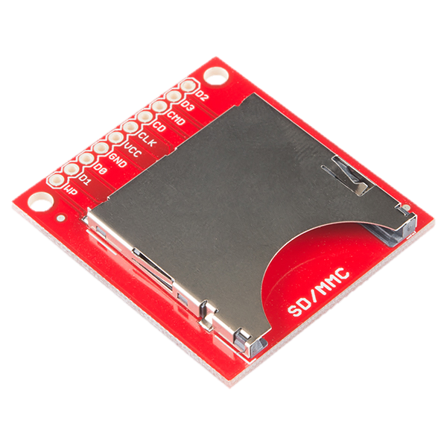
Audio Storage
SparkFun BOB-00544
Enough storage for five instruments’ audio files
Accessed and read in real time
Stores when instrument is off
Rewriteable for future modification
$4.50 per unit
Notes:
Luke
List the five instruments: piano, string, brass, woodwind, percussion
MP3 goes on SD, MIDI goes to MCU

Slide 19
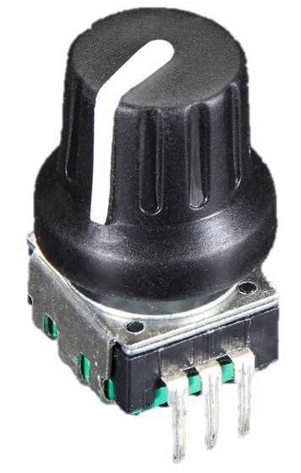
Auxiliary Input
Rotary encoder is placed on the outside of the device
Chooses instrument to play
On/Off switch for device power on/off
Notes:
Erik
In order to give users the ability to change the instrument they hear with the notes being played, a rotary encoder will be used to switch between available instruments. Users will see selections as they scroll through on the LCD. To give users the choice of turning the device on and off, an on/off switch will be included on the side of the device, allowing power to flow to components or to completely cut it off.

Slide 20
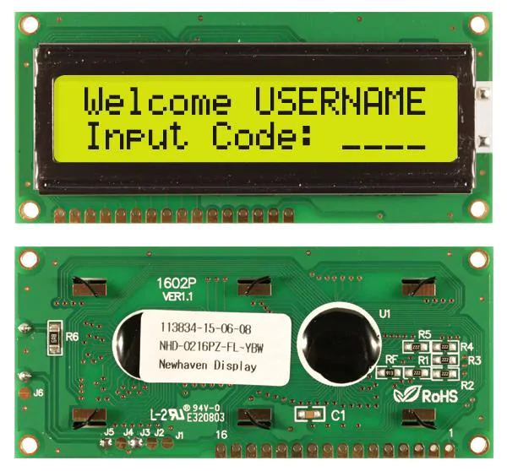
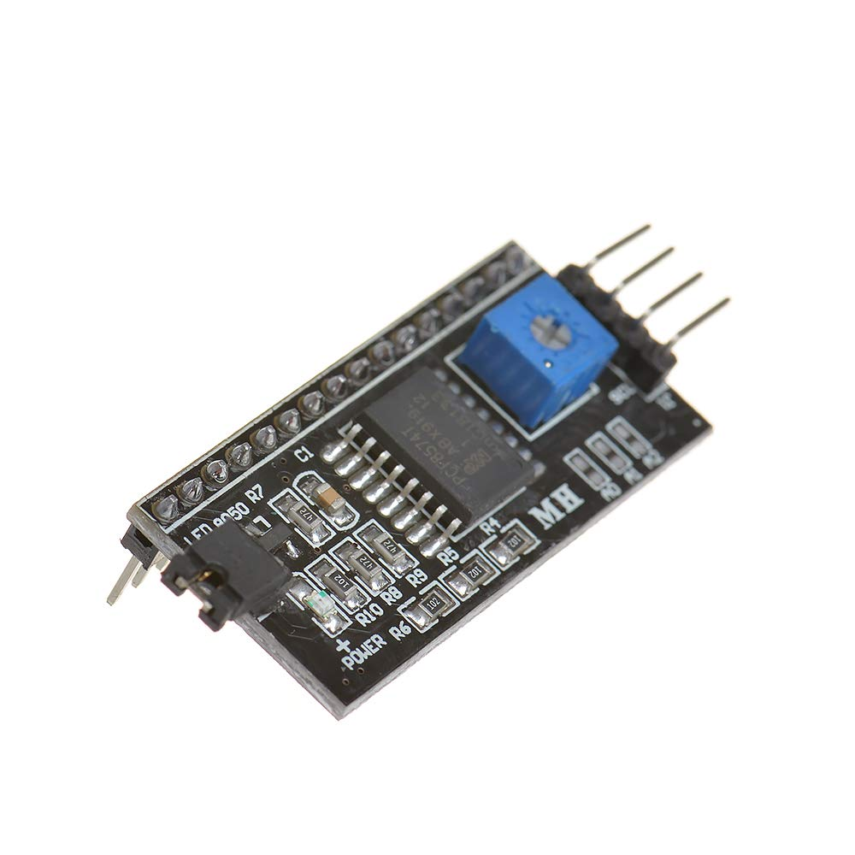
LCD
Newhaven LCD
$10.75
Supply Voltage: 5 V
16 characters by 2 lines
I2C protocol to communicate with LCD
Notes:
Erik
- Chose to implement an LCD to enhance the user interface
- We will be using a 16 by 2 LCD graphical display
- cheapest option for price vs versatility
- Black board helps implement I2C protocol and reduces number of I/O pins used on MCU

Slide 21
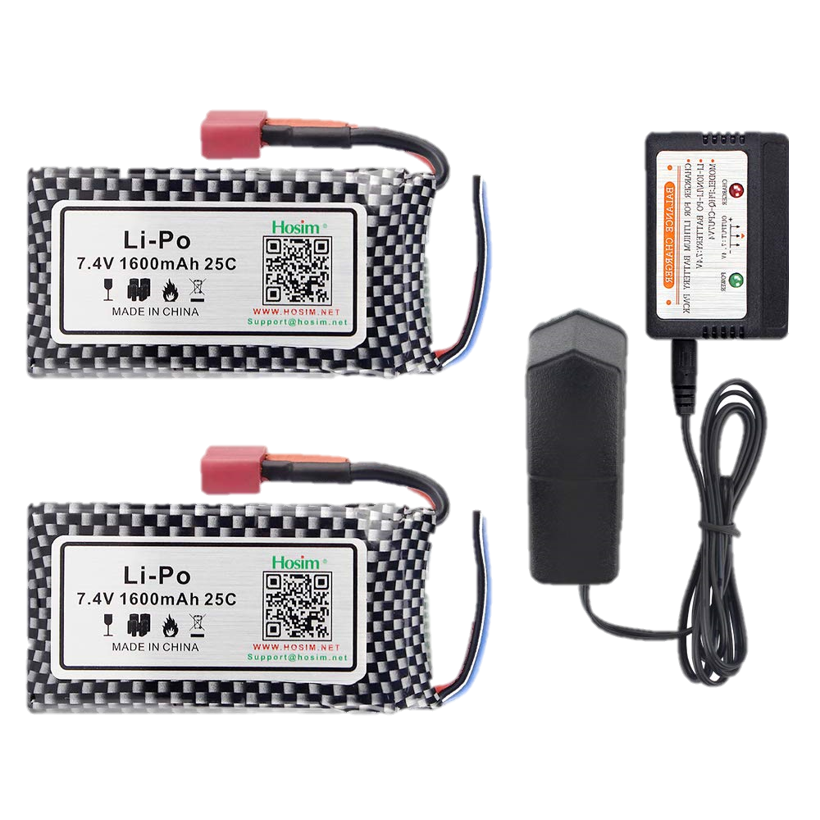
Battery and Power
7.4 V Lithium Polymer (LiPo) battery
Rechargeable battery
Hosim 7.4 V 1600 mAh
Balance charger
Notes:
Erik
- We decided on using a lithium polymer
- Great choice in rechargeable batteries
- Since we are using a two cell LiPo, a Balance Charger would be needed.
** Slide 1) LiPo and rechargeable circuit
** Slide 2) Voltage specs (lasers, sensors, LCD, MCU, speakers, etc.)

Slide 22
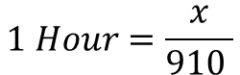
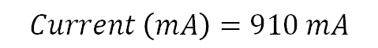
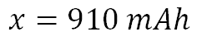
Battery and Power cont.
3.3 V Rail |  | 3.45 V Rail |  | 5 V Rail
Part | Current (mA) | Part | Current (mA) | Part | Current (mA)
MCU | 400 | Laser Diode (x8) | 160 | Amplifier | 50
Photo Transistor (x8) | 160 |  |  | LCD/I2C | 125
 |  |  |  | Rotary Encoder | 15
Total | 560 | Total | 160 | Total | 190
$$Current \left(mA\right)=560+160+190$$
$$1 Hour=\frac{x}{910 }$$
$$Current \left(mA\right)=910 mA$$
$$x=910 mAh$$
Notes:
Erik

Slide 23
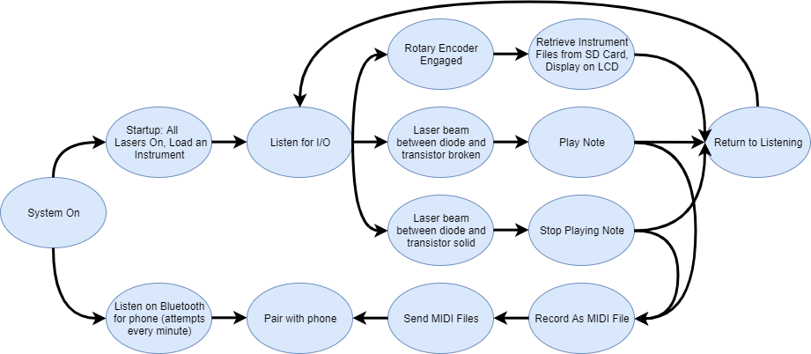
MCU – Flow Diagram
Notes:
Krystyn
So, as soon as the device instrument powers on, we’ll start to scan for devices to see if the user would like to connect their phone to it. But as that’s an extra feature, the primary focus on startup will be to immediately begin the process of fetching stored files from the SD card to RAM for faster note retrieval. All laser diodes will turn on, initializing the state that an unbroken laser beam means that the note is not being played. Once startup procedures are done, the device will wait for an I/O change, such as a change for another instrument and therefore retrieval of those files, or a laser beam is broken, so a note is played and there is a MIDI byte of data written. The device will constantly be waiting for any changes in input or output once the newest information has been recorded.

Slide 24
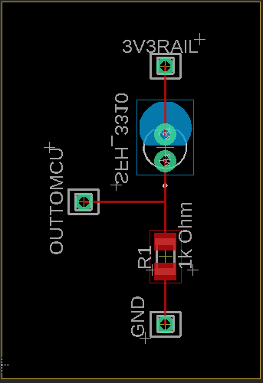
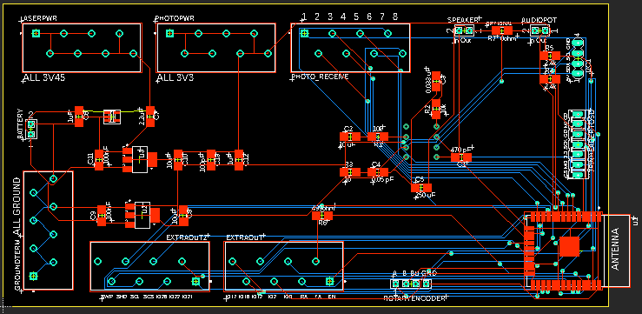
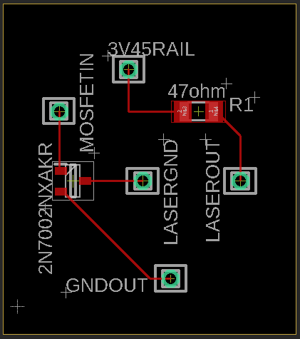
PCB
Notes:
Krystyn

Slide 25
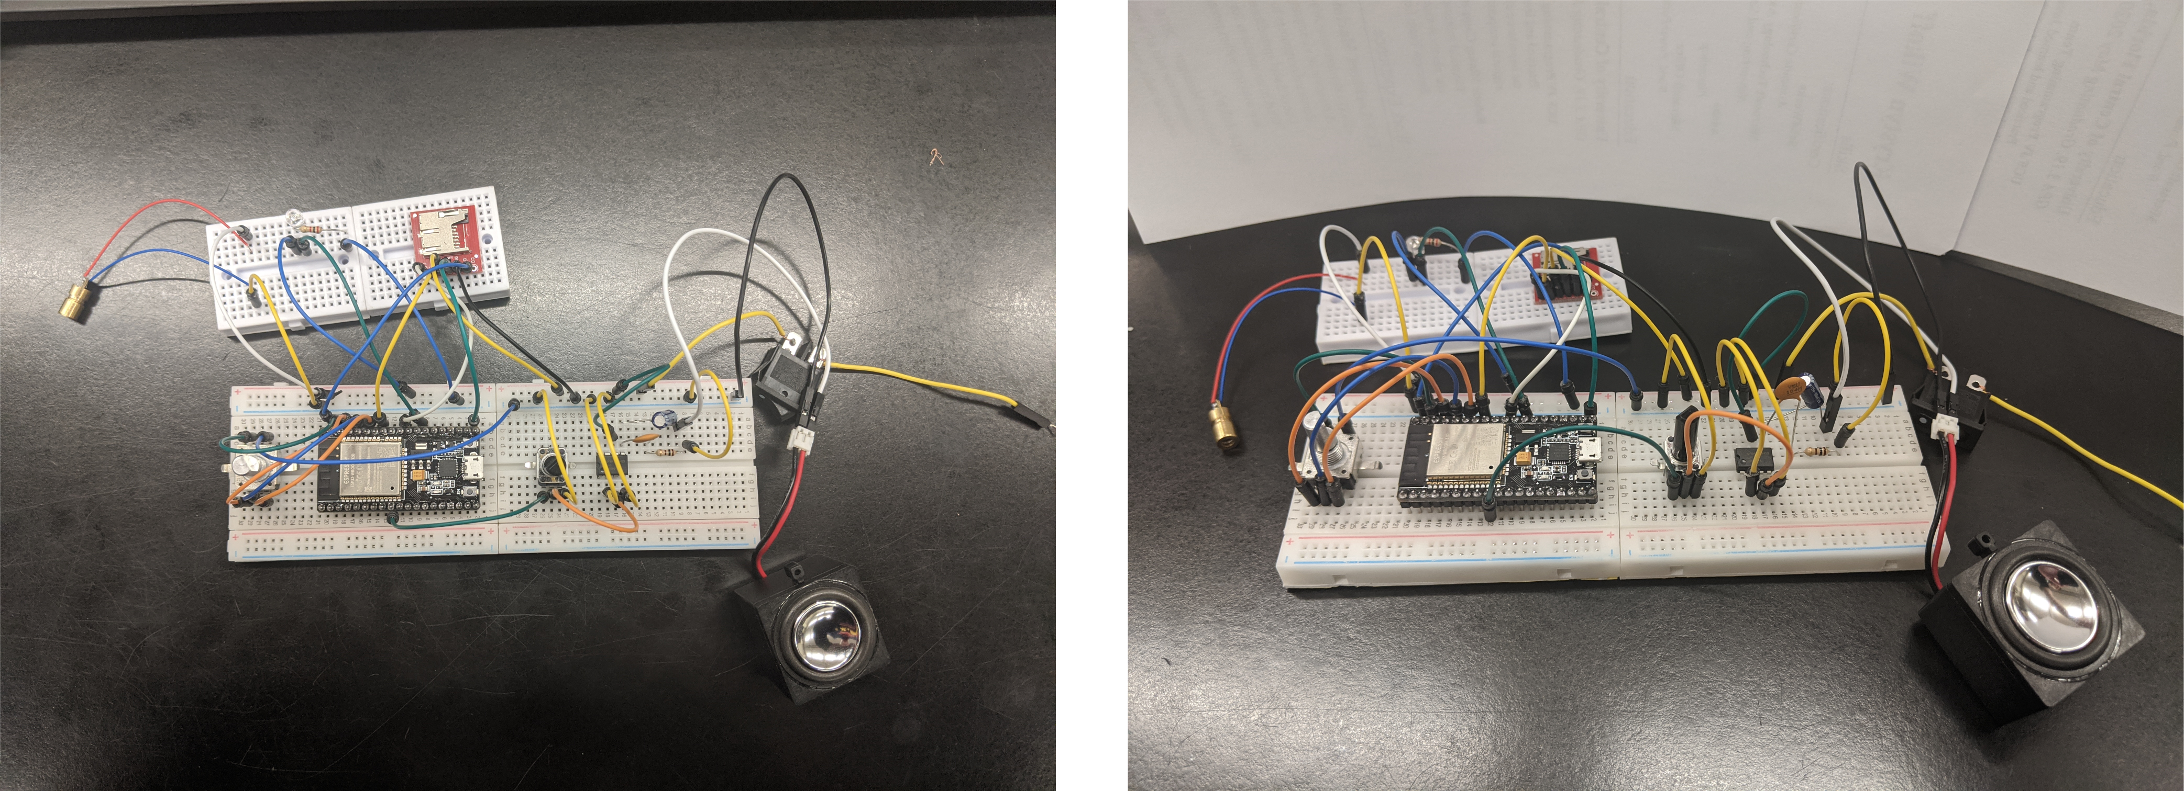
First Prototype
Notes:
Krystyn
Will eventually include a frame prototype pic

Slide 26

Application Software
Android for app platform
Android Studio allows emulations and fast layout options
Bluetooth and Bluetooth Low Energy exist as verbose libraries for Android
BLE consumes almost half the power of Wi-Fi, and less than regular Bluetooth
Android MIDI handling libraries with excellent documentation
Notes:
Luke – Say words
We have decided to use Android for our application because it is cheaper and we have experience as a group working with it before. The Android platform has libraries for handling Bluetooth, BLE, and MIDI, so it was the obvious choice for our application. Android Studio is the standard IDE for Android development, and we have experience with it as a team. It supports emulation for multiple devices so we are able to test our application for a large range of users.
Add another slide with app prototype?

Slide 27
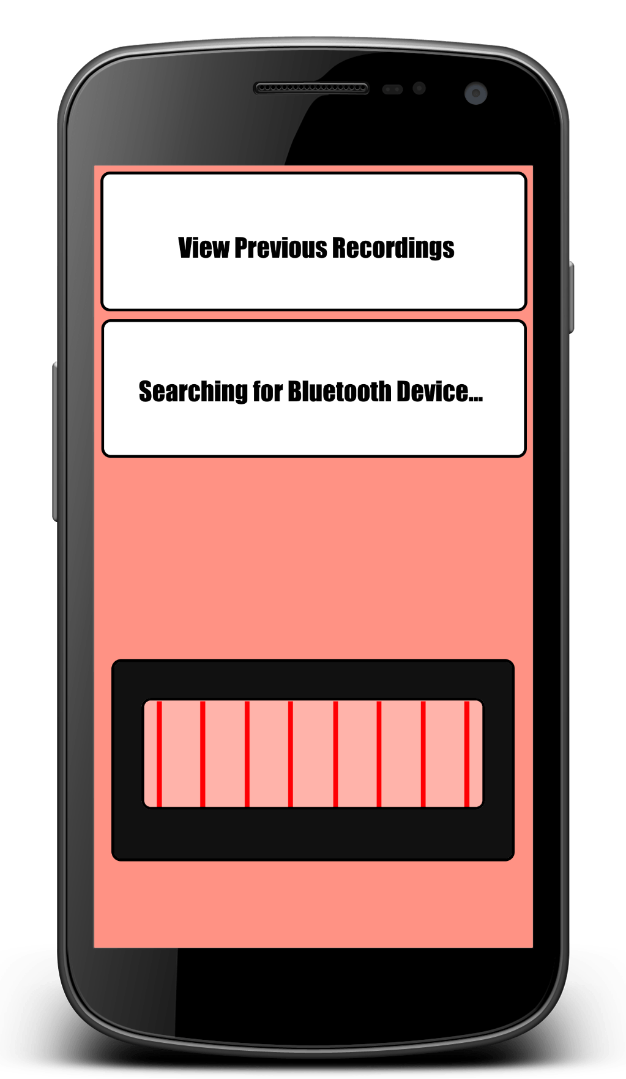
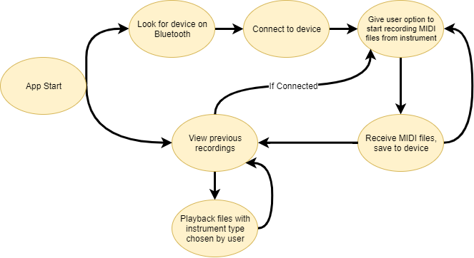
Application Flow
Notes:
Luke
This is not very large due to the app existing to supplement the device, not to be a requirement

Slide 28
Administrative

Slide 29
Work Distribution
 | Power | Sensor Config. | PCB | Frame | Auxiliary | Audio System | Mobile App
Luke |  |  | Secondary | Primary |  |  | Primary
Alexis | Secondary | Primary |  | Secondary |  |  | Secondary
Erik | Primary |  |  |  | Primary
Krystyn |  |  | Primary |  | Primary | Primary
Notes:
Alexis
Primaries are also responsible for the component’s firmware MCU

Slide 30
Cost Per Device
Item | Budget Item | Unit Price (USD) | Quantity | Subtotal (USD)
Frame Hardware | Frame | $30.00 | 1 | $30.00
PCB Print | PCB Print | $30.00 | 1 | $30.00
SGT5516GK Phototransistor | Photo Sensors | $0.21 | 8 | $1.68
HiLetgo 5V 650nm 5mW Red Dot Laser | Laser Diodes | $0.55 | 8 | $4.40
Power Source and Charger | Battery/ Power | $22.00 | 1 | $22.00
Mouser Power Regulator |  | $0.40 | 3 | $1.20
Speaker | Audio Output | $3.42 | 2 | $6.84
Mouser LCD |  | $10.75 | 1 | $10.75
ESP32-WROOM-32D | MCU, Bluetooth | $3.80 | 1 | $3.80
Audio Amplifier | Audio Output | $1.17 | 1 | $1.17
Rotary Encoder | Dials/Switches | $4.50 | 1 | $4.50
Potentiometer | Audio Output | $0.84 | 1 | $0.84
Power Switch | Battery/Power | $0.81 | 1 | $0.81
SparkFun MicroSD Board | Memory Card Reader | $4.50 | 1 | $4.50
SanDisk MicroSD | Memory Card | $12.52 | 1 | $12.52
Total |  |  |  | $135.01
Notes:
No sponsors
Self funded group

Slide 31
Progress
Notes:
Alexis

Slide 32
Issues
Final PCB design
Power supply design
I2C not properly working
Expected Issues:
Audio file retrieval and playback
Notes:
Erik
- Trouble finalizing some parts
- Testing the power
- I2C is finding all addresses or none
- audio issues in future

Slide 33
Questions?
Notes:
Erik

